Slide 1


FOOF RBG Wiring https://github.com/Mark-MDO47/RubberBandGun
… the AWESOME
2020-09-10

Slide 2
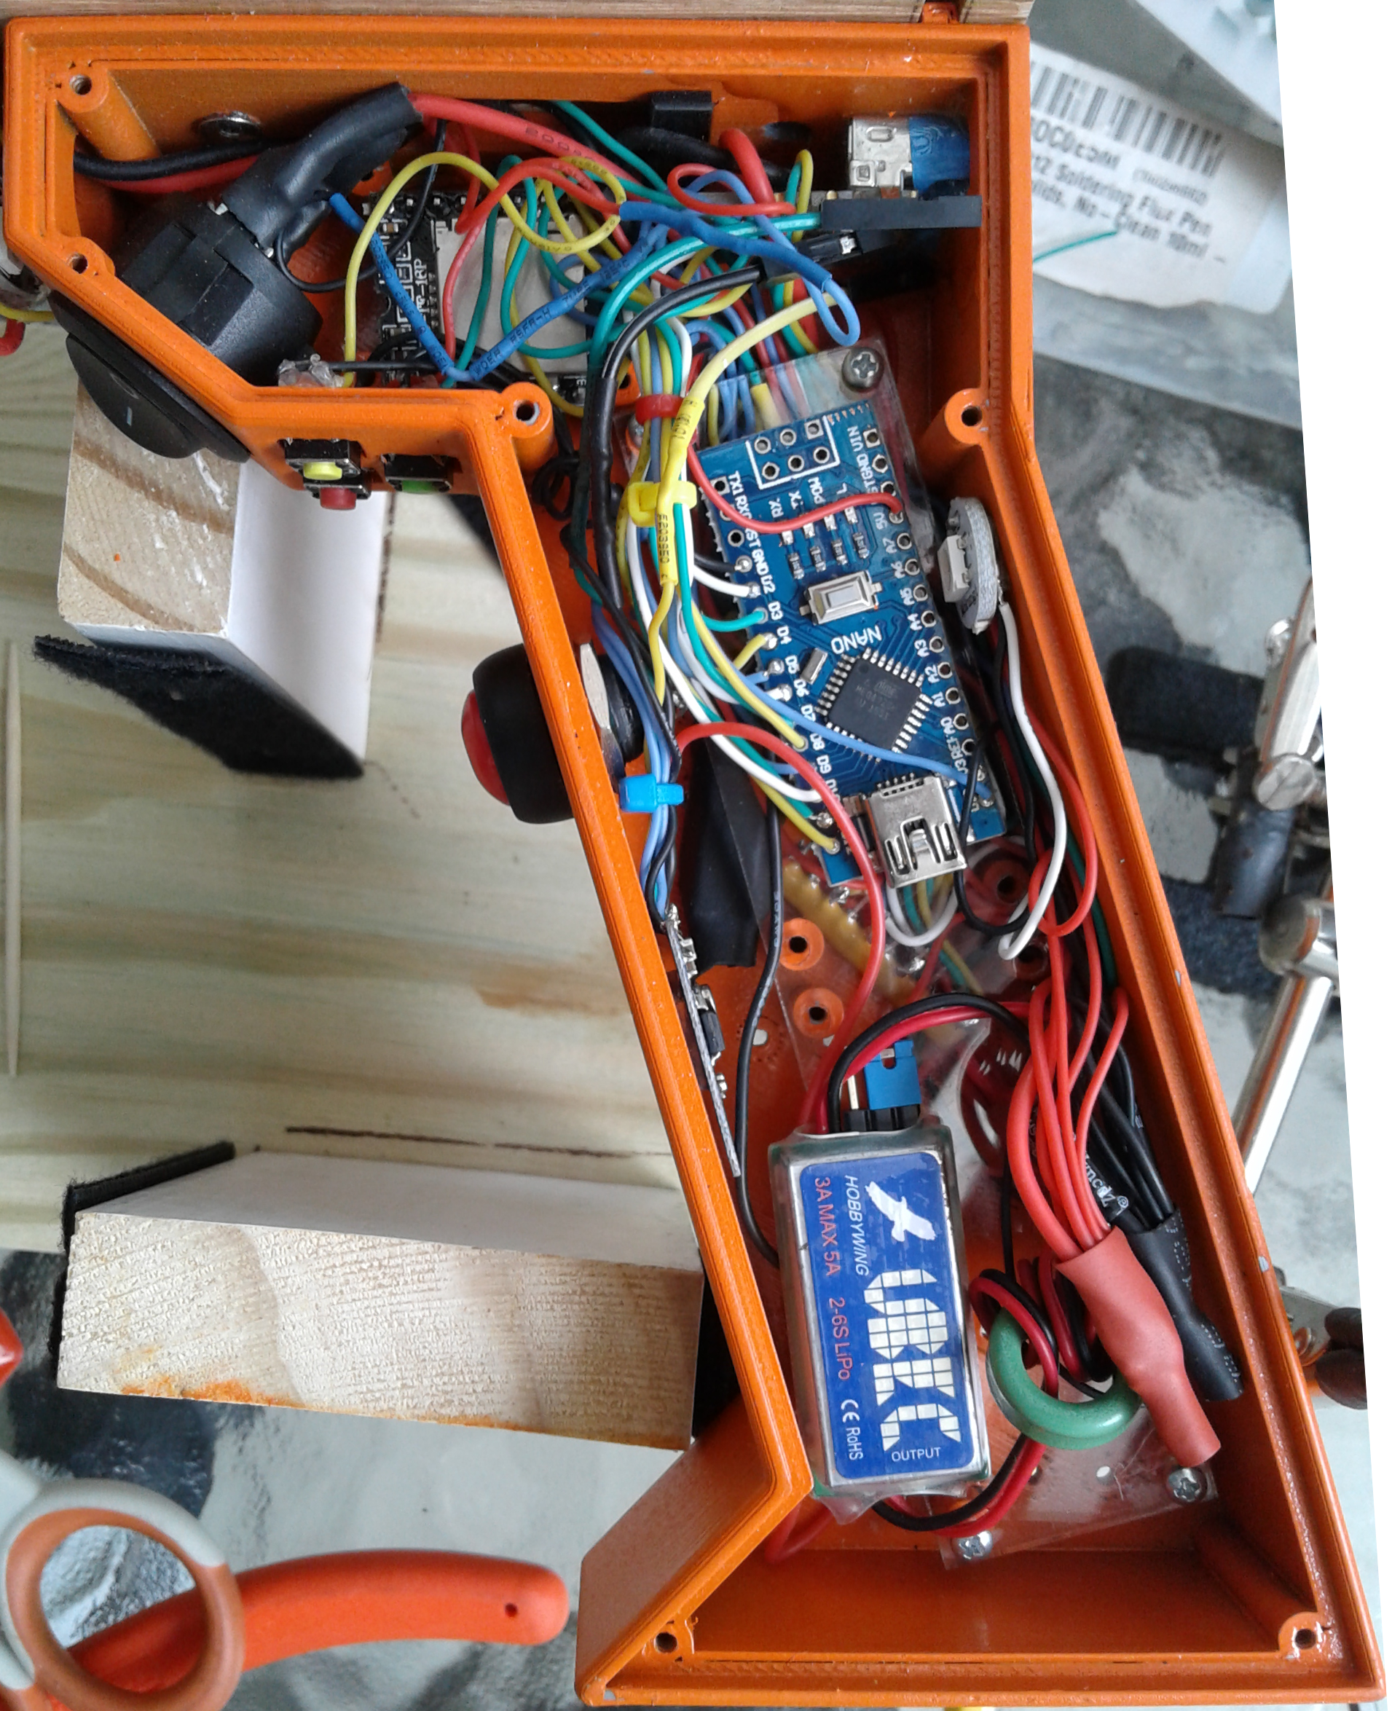
FOOF RBG Electronics Compartment
YX5200
Ardu
125
10K
KCX
IN
UBEC

Slide 3
FOOF RBG 8.3V Power
Battery 8.3V: 1 connection:
- on/off switch
Post-Switch 8.3V: 3 connections:
- on/off switch
- USB Red Wire
- UBEC +V Input
Battery 8.3V
20 AWG
USB 8.3V
Red Wire
YX5200
Ardu
125
10K
KCX
IN
UBEC

Slide 4
FOOF RBG 5V Power
LED Rings 5V
20 AWG
UBEC 5V output: 7 connections:
- LED Rings 5V 20 AWG
- YX5200 pin “01”
- Arduino pin “5V”
- Single LED “5V”
- SN74HCT125N pin “14”
- 10K Ohm SIP pin (with lettering)
- KCX_BT_EMITTER pin “+5V”
- 100 uF capacitor +side
CHECK THE LIST
YX5200
Ardu
125
10K
KCX
IN
UBEC

Slide 5
FOOF RBG Ground
LED GND
20 AWG
Note: UBEC grounds CONNECTED
LED GND 20 AWG : 8 connections:
- USB Black Wire
- YX5200 pin “10”
- 3 @ configuration buttons
- Arduino pin “GND”
- UBEC GND input
- UBEC GND output
- SN74HCT125N pin “07”
- KCX_BT_EMITTER pin “GND”
YX5200
Ardu
125
10K
KCX
IN
UBEC

